Slide 1
MOVIE RECOMMENDATION SYSTEM
TEAM MEMBERS:
2420030517-Tejaswi Chowdary
2420030606-Harshith Reddy
2420030613-Hasini Reddy
Project Guide: Dr . Sunanda N

Slide 2
Introduction
The Movie Recommendation System uses Data Science, NLP and Machine Learning techniques to analyse movie characteristics and recommend similar movies to users. The system uses Content-Based Filtering, TF-IDF and Cosine Similarity, with a Stream lit dashboard for user interaction.

Slide 3
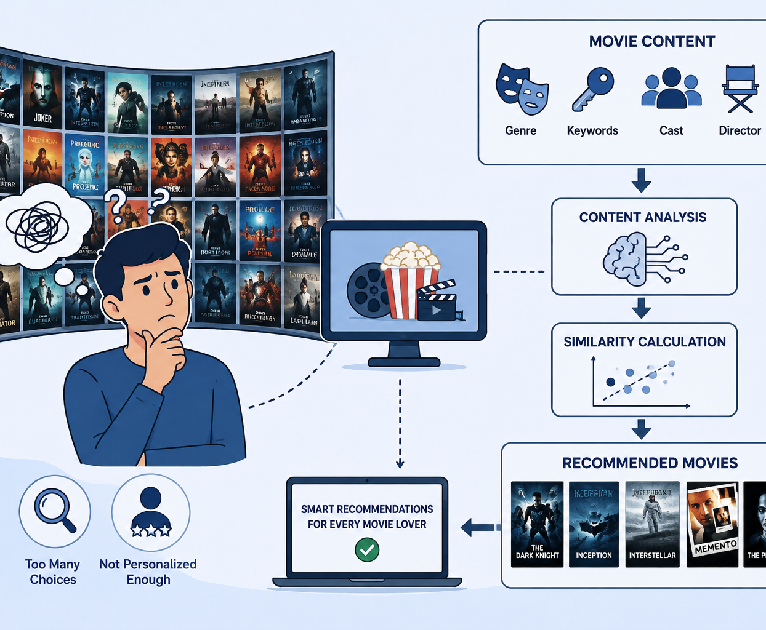

Problem STATEMENT
With a large number of movies available, users may find it difficult to discover movies according to their interests and preferences.
Manually searching through many movies can be time-consuming.
Different movies have different characteristics such as genre, keywords, cast, director, and description.
There is a need for an intelligent system that can analyze these movie characteristics and recommend relevant movies.
Our project develops a Content-Based Movie Recommendation System that recommends movies similar to a movie selected by the user.

Slide 4
Real-World Relevance & Motivation
Real-World Relevance :
The availability of thousands of movies makes it difficult for users to find movies that match their interests.
Users often spend considerable time browsing and searching for suitable movies.
A recommendation system can help users discover relevant movies quickly and efficiently.
Movie information such as genre, keywords, cast, director, and description can be analysed to identify similar movies.
Motivation:
To reduce the time and effort required to search for movies.
To provide recommendations based on the actual characteristics of movies.
To apply Data Science, NLP, and Machine Learning techniques to a real-world problem.
To develop a simple and user-friendly system through a Stream lit dashboard.
Content-Based Filtering allows the system to recommend movies without depending on other users' ratings or preferences.

Slide 5
Objectives and Expected Outcomes
Objectives:
Collect and preprocess the movie dataset by handling missing and unnecessary data.
Select important movie features such as genre, keywords, cast, director, and description.
Combine the selected features to create a meaningful representation of each movie.
Apply TF-IDF to convert textual information into numerical feature vectors
Recommend the most similar movies based on the movie selected by the user.
Expected Outcomes:
A cleaned and pre-processed movie dataset.
A Content-Based Recommendation Model using TF-IDF and Cosine Similarity.
A ranked list of similar movie recommendations.
An interactive Stream lit dashboard where users can select a movie and view recommendations
Demonstration of practical applications of Data Science, NLP, Feature Extraction, and Machine Learnin

Slide 6
Literature Survey / Existing System
Popularity-Based Recommendation — recommends highly rated, trending, or frequently watched movies.
Content-Based Filtering — recommends movies with similar characteristics to a selected movie or user profile.
Collaborative Filtering — uses ratings or interactions from users with similar tastes.
Hybrid Recommendation — combines content-based and collaborative approaches.
Real-world platforms such as Netflix, YouTube, and other streaming services use recommendation techniques to personalize content discovery.

Slide 7
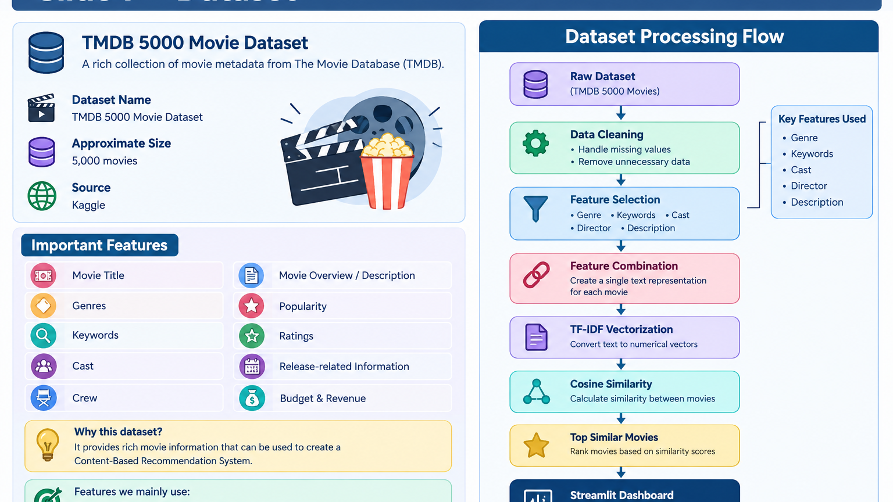


Slide 8
Proposed System & Methodology
Data Preprocessing – Clean and prepare the movie dataset.
Feature Selection – Use genre, keywords, cast, director and description.
TF-IDF – Convert movie text into numerical vectors.
Cosine Similarity – Calculate similarity between movies.
Recommendation – Select and rank the most similar movies.
Stream lit Dashboard – Display recommendations to the user.
Flow:
Dataset → Preprocessing → Feature Selection → TF-IDF → Cosine Similarity → Recommendations → Stream lit

Slide 9
Conclusion
The Movie Recommender System helps users easily discover movies that match their
interests by analyzing movie features and preferences.
It provides relevant and personalized recommendations, reducing the time users spend
searching for movies.
Key Points:
Provides personalized movie recommendations.
Identifies similar movies based on features.
Reduces movie search time.
Improves the user viewing experience.
Uses Machine Learning techniques for recommendation.

Slide 10


